Slide 1
SystemVerilog Assertions
Copyright © 2021 Intel Corporation.
This document is intended for personal use only.
Unauthorized distribution, modification, public performance,
public display, or copying of this material via any medium is strictly prohibited.

Slide 2
Session Topics
Introduction to Assertions
Immediate and Concurrent Assertions
Examples
SystemVerilog Regions
Assertion based Verification
Overview of Assertion Properties

Slide 3
Revisit of SystemVerilog Training Part 1
Synthesizable Constructs
Introduction to the SV data type (2 state and 4 state data types)
Implicit .name and .* associations
Specialized always procedural blocks
Enumerated data types

Slide 4
Revisit of SystemVerilog Training Part 2 (Mostly on the Verification constructs)
Packed and Unpacked arrays
Dynamic Arrays
Associative Arrays
Queues
Structures and Unions
Class and Object

Slide 5
Key takeaways of the training with hands-on labs
Assertions
Immediate Assertions
Concurrent Assertions
Overlapped Implication
Non-overlapped Implication
$rose and $fell
Assertion statements
Perform simulation using Questa- Intel FPGA starter edition

Slide 6
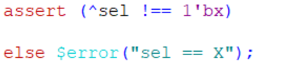
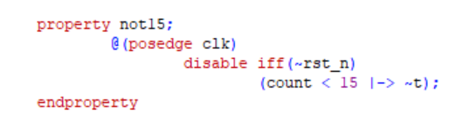
Key take aways with hands-on labs – Part 3
Checking the validity of the inputs and select lines – Immediate Assertions
Concurrent Assertions with Implication operator
SystemVerilog built-in edge expressions

Slide 7
Introduction to Assertions
What is an assertion?
The parents statement translates into two properties
Assertions are not really a new concept
Property 1: “if hungry and there are more than 9 cookies then you must eat a cookie”. If a cookie is not eaten by the next hour clock, then it is an error.
Sample Assertion
A parent may tell a child
“there are 10 cookies in the cookie jar and during the day, if you are hungry, you may at most take one cookie! At the end of the day I want to see at least 9 cookies in the jar and … and I’ll count the number of cookies every hour”
Property 2 : There should never be less than 9 cookies in the jar
No
No (check every hour)
hungry
Cookie count <9
Representing Assertions
Yes
Yes
SystemVerilog assertions are represented as a property that defines intent and the property is enforced by using the assert statement
Cookie count>9
Yes
No
Punish kids
Eat a cookie
Don’t Eat a cookie
Property 2
Property 1

Slide 8
Assertions and their benefits
An assertion is a statement about a design’s intended behavior (that is, a property), which must be verified.
Key verification benefits that assertions provide include:
improved error detection
improved error isolation
improved error notification
These benefits are a result of improved observability (when assertions are embedded in the design).
Other benefits include:
Reduced debug time—up to 50%
Improved integration through correct usage checking
Improved verification efficiency through specification
Improved communication through documentation

Slide 9
Features of SystemVerilog Assertions
Easily usable by both design and verification engineers
Reusable across both simulation and formal
No modifications and consistent results
Semantically the same as Open Vera Assertions [OVA] – familiar usage
Flexible implementation – inlined or separate file
Addresses and documents design decisions
Documents design properties and assumptions
Provides excellent basis for design and verification reviews
Simplifies design of testbench reference models or score boards, which verifies the correctness of results
Guides testbench vectors for conditions to be addressed

Slide 10
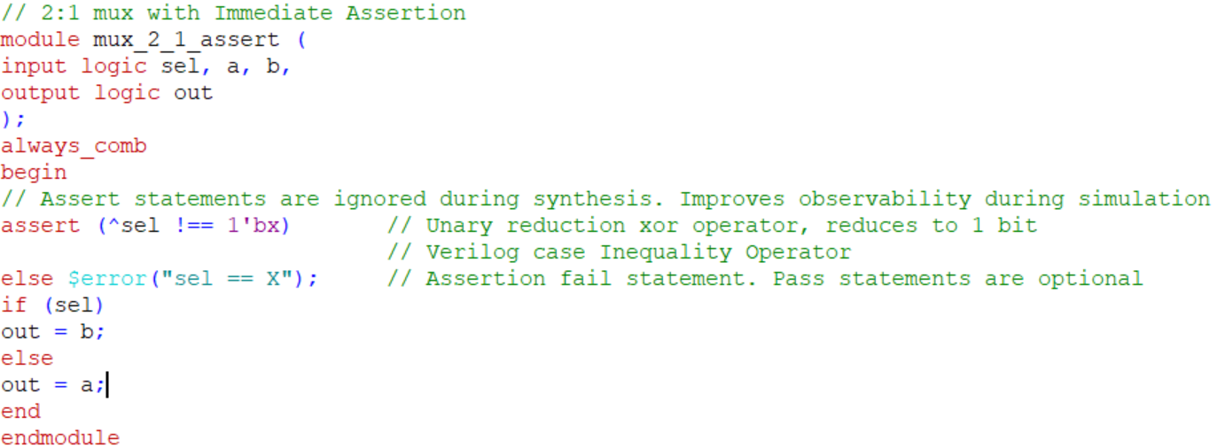
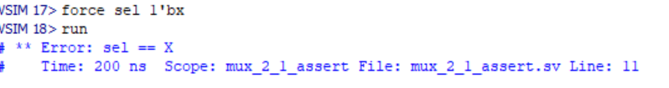
Assertion Example 1
OUTPUT

Slide 11
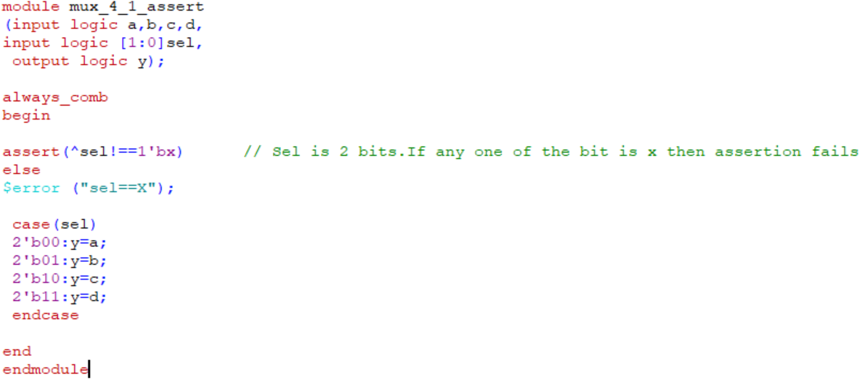
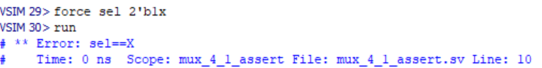
Assertion Example 2
OUTPUT

Slide 12
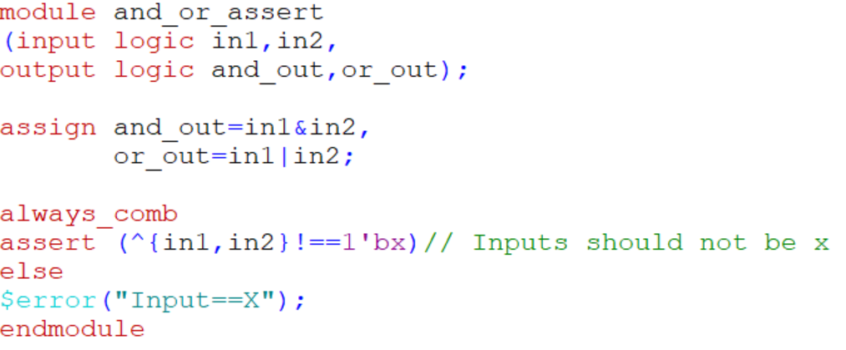
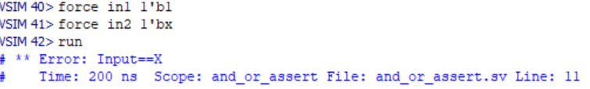
Assertion Example 3
OUTPUT

Slide 13
Assertion improves Observability
A piece of verification code used to check a property
correct/illegal behavior
assumptions/constraints
coverage goals
Examples:
Interface A must follow the PCI protocol
Bus B must be one-hot
The FIFO must never overflow
Back-to-back reads/writes
Write will follow read 3 cycles

Slide 14
Why SVA and why not Verilog?
Verilog is a procedural language and hence, does not have good control over time.
Verilog is a verbose language. As the number of assertions increase, it becomes very difficult to maintain the code.
The procedural nature of the language makes it difficult to test for parallel events in the same time period. In some cases, it is also possible that a Verilog checker might not capture all the triggered events.
Verilog language has no built-in mechanism to provide functional coverage data. The user must produce this code.

Slide 15
SystemVerilog Assertion Based Verification
Assertions were developed to provide system engineers, designers and verification engineers the means to describe complex behaviors about the design requirements and properties in a clear & concise manner
Assertion based verification helps to categorize the design intent and expected operations
Assertion based verification also guides the verification task, quickens the verification because it provides feedback at the white box level and eases the design of the testbench as it transfers more of the “verifier” task to the assertions, instead of the user-defined model
SVA allow the verification environment to be reactive, which implies that based on results of the assertions (Pass or Fail) different actions may be taken

Slide 16
SystemVerilog Assertion Statements
SystemVerilog has two types of formal assertion statements: immediate assertions and concurrent assertions. Both immediate and concurrent assertions perform a test on an aspect of the design. At the completion of the test, pass or fail statements can be executed. In addition to the fail statements, the failure severity level can be set for each assertion. The severity levels are set by calling system tasks which include:
• $fatal — run-time fatal – exit the simulator when assertion fails – high severity
• $error — run-time error
• $warning — run-time warning
• $info — provide the note that the assertion failed, but without any severity

Slide 17
Steps to create SystemVerilog Assertions

Slide 18
Immediate and Concurrent Assertions
Assertion: An Assertion specifies the behavior of the system. They are primarily used to validate the behavior of the design
Immediate Assertions: Immediate assertions follow simulation event semantics for their execution and are executed like a statement in a procedural block. Immediate assertions are primarily intended to be used with simulation.
Concurrent Assertions: Are based on clock semantics and use sampled values of variables. Concurrent assertions describe behavior that spans over time.

Slide 19
Overview of Properties and Assertions
Immediate Assertions
Immediate Assertions: An immediate assertion is a test of an expression performed when the statement is executed in the procedural code.
immediate_assert_statement ::=assert ( expression ) action_block
Syntax for Immediate Assertions
Expression is interpreted the same way as an expression in the condition of a procedural if statement
If the expression evaluates to X,Z or 0 then it is interpreted as being false and the assertion is said to fail. Otherwise, the expression is interpreted as being true and the assertion is said to pass
Are useful when added along with the RTL code
19

Slide 20
Immediate Assertions
Immediate assertions, as the name implies, execute immediately, in zero simulation time
The syntax for an immediate assertion is:
assert (expression) [pass_statement;] [else fail_statement;]
Note that the pass_statement is optional.

Slide 21
Concurrent Assertions
Concurrent Assertions – Concurrent assertions describe behavior that spans over time.
Unlike immediate assertions, the evaluation model is based on a clock such that a concurrent assertion is evaluated only at the occurrence of a clock tick.
The values of variables used in the evaluation are the sampled values.
Concurrent assertions like these are checked throughout simulation. They usually appear outside any initial or always blocks in modules, interfaces and programs.
Concurrent assertions (assert property and cover property statements) use a generalized model of a clock and are only evaluated when a clock tick occurs

Slide 22
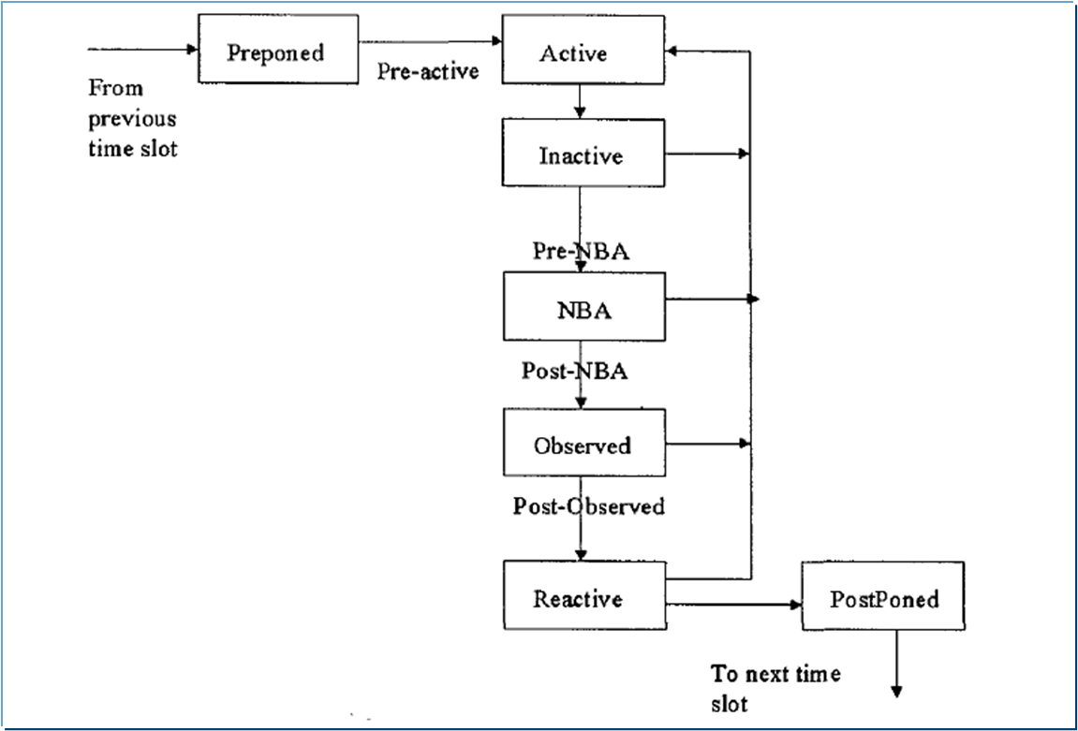
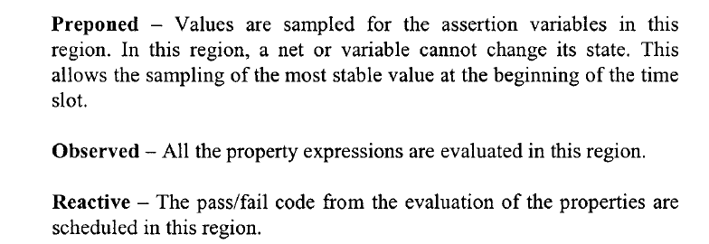
SystemVerilog Regions

Slide 23
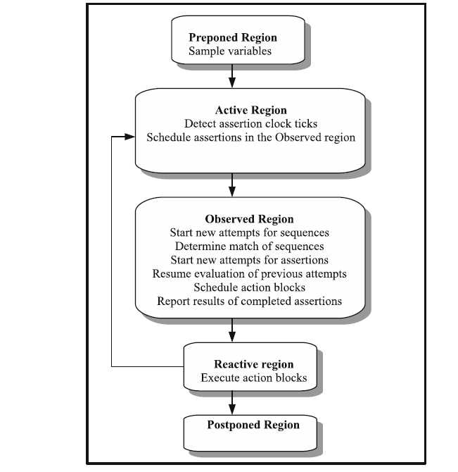
SystemVerilog Regions

Slide 24
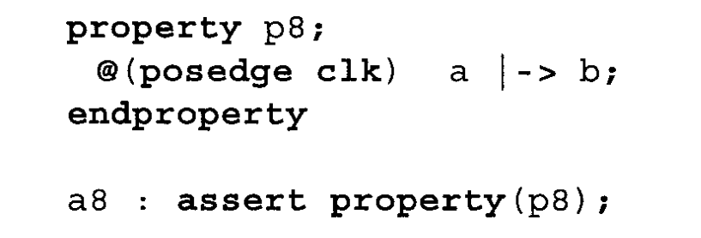
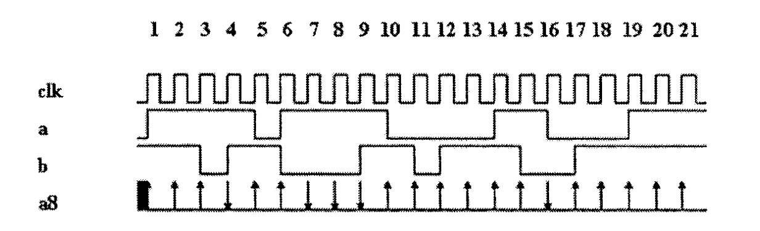
Overlapped Implication Operator
Implication is equivalent to an if-then structure. The left-hand side of the implication is called the "antecedent" and the right hand side is called the "consequent
Overlapped implication is denoted by the symbol |->. If there is a match on the antecedent, then the consequent expression is evaluated in the same clock cycle. A simple example is shown below in property p8.
This property checks that, if signal "a" is high on a given positive clock edge, then signal "b" should also be high on the same clock edge.
All successes are shown with an up arrow and all failures are shown with a down arrow.

Slide 25
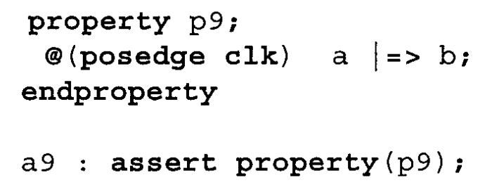
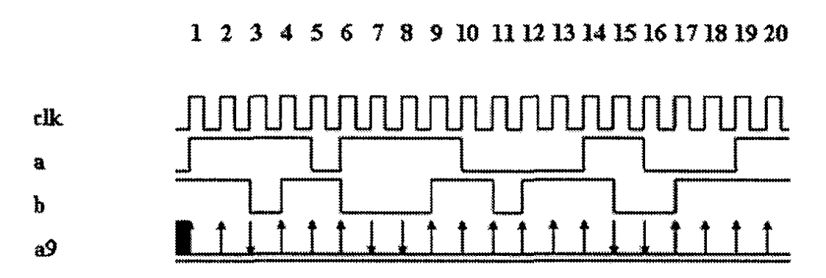
Non-Overlapped Implication Operator
Non-overlapped implication is denoted by the symbol |=>.
If there is a match on the antecedent, then the consequent expression is evaluated in the next clock cycle.
A delay of one clock cycle is assumed for the evaluation of the consequent expression.
A simple example is shown below in property p9. This property checks that, if signal "a" is high on a given positive clock edge, then signal "b" should be high on the next clock edge.

Slide 26
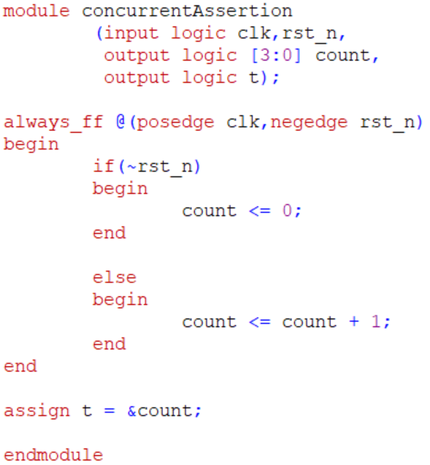
Counter Example – Concurrent Assertions

Slide 27
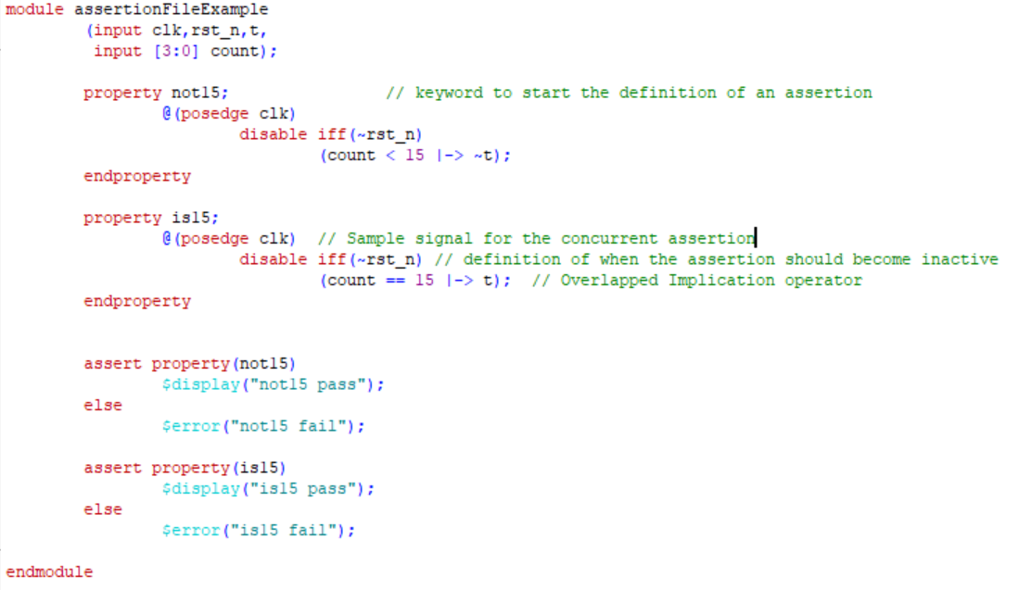
Counter Example – Assertion Property file

Slide 28
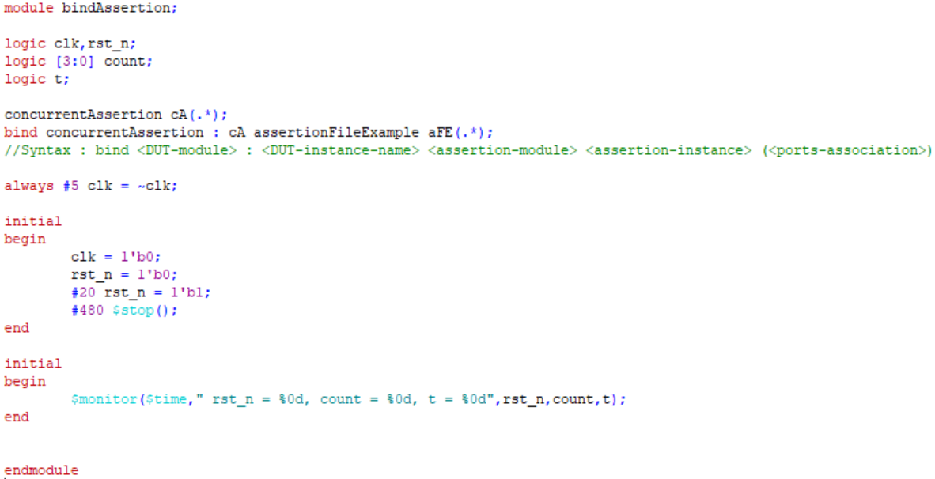
Binding Assertions in the Testbench

Slide 29
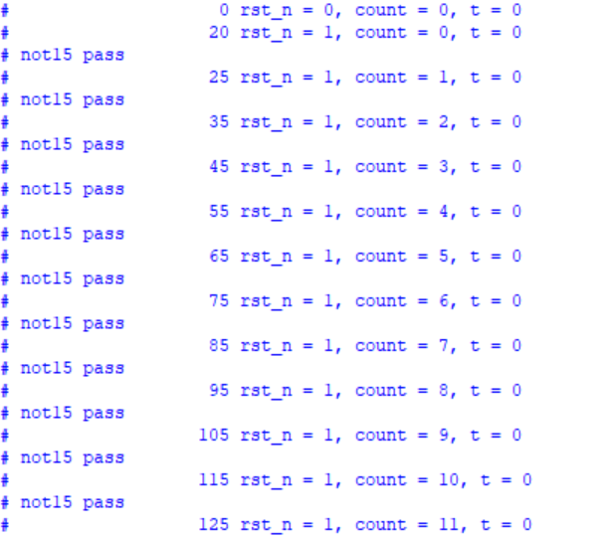
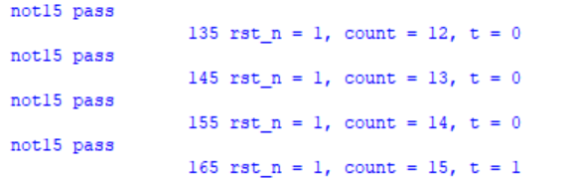
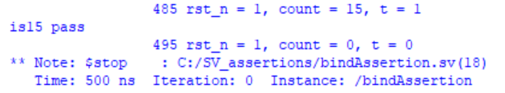
Output

Slide 30
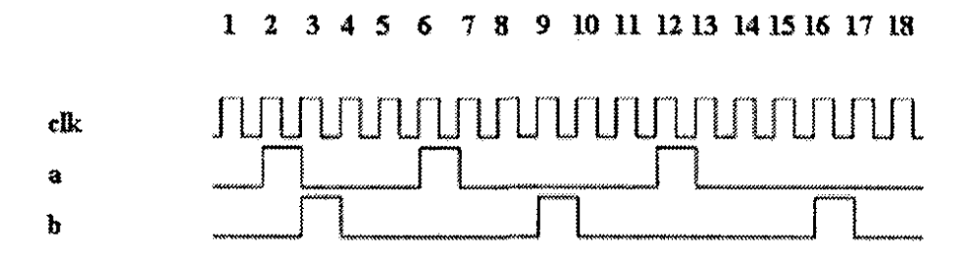
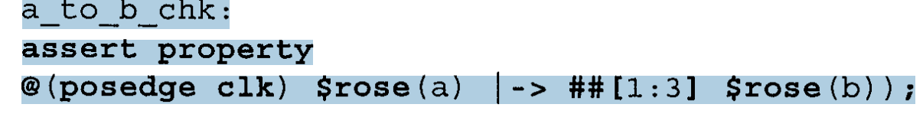
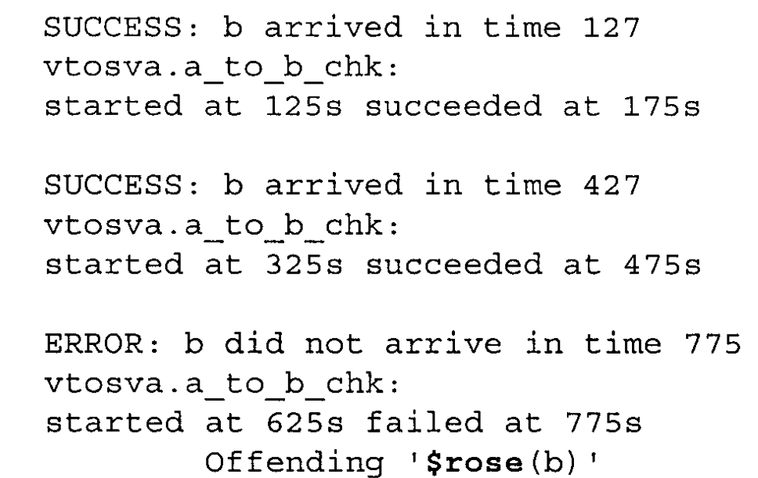
$rose and $fell
The checker verifies that if signal "a" is high in the current clock cycle, then signal "b" should be high within 1 to 3 clock cycles

Slide 31
Assertion Statements
Reset rst must be initially high and be low in clock tick 20.
a1: assert property (@(posedge clk) rst ##20 !rst);
The value of a should be always true starting from clock tick 2.
a1: assert property (@(posedge clk) ##2 a);

Slide 32
Assertion Statements
When rdy is asserted rst must be low.
assert property (@(posedge clk) rdy |-> !rst);
done must be asserted in the next clock tick after sent has been asserted.
assert property(@(posedge clk) sent |-> ##1 done);
assert property(@(posedge clk) sent ##1 1 |-> done);

Slide 33
Views about assertions from DV Engineers
Where am I going to find time to write assertions? I don’t even have time to write comments in my code!
I have to get my design working first. If there is time later, then I ’ll add assertions
I will spend more time debugging the assertions than debugging my code; therefore, they are a waste of time.
I can’t think of any assertions to put in my code. There are no places for them.
The assertions slow down simulations. They are a waste of time.
Designers shouldn’t check their own code. Hence, adding assertions violates this rule.
It is difficult to debug with assertions. It’s not possible to fail an assertion and continue debugging.

Slide 34
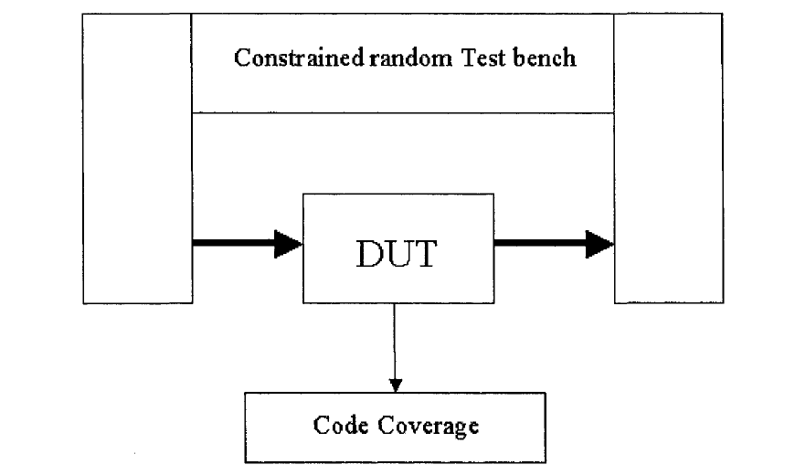
Before Assertion based Verification

Slide 35
Code Coverage with SV assertions
Code coverage is used to measure the efficiency of verification implementation.
It provides a quantitative measurement of the testing space.
It describes the degree to which the source code of a DUT has been tested. It is also referred as structural coverage.
It is also known as Quantitative Coverage

Slide 36
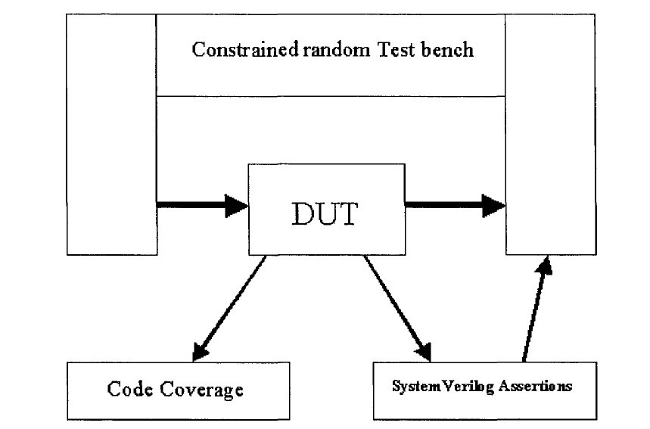
After SystemVerilog Assertions

Slide 37
Review of the key take aways
Checking the validity of the inputs and select lines – Immediate Assertions
Concurrent Assertions with Implication operator
SystemVerilog built-in edge expressions

Slide 38
Assertions: Points to Ponder
Using assertions with an RTL file is simple to do.
Assertions can be employed by:
adding the assertions directly into the RTL source code.
placing the assertions into a separate file and including the file into the RTL source code using the `include compiler directive.
placing the assertions into a separate module (also in a separate file) and instantiating the module into the RTL source code.
placing the assertions into a separate module (separate file) and binding the module to the design from a third module, such as a testbench

Slide 39
References
Assertion based design – Harry Foster
A Practical Guide for SystemVerilog Assertions – Srikanth Vijaya Raghavan and Meyyappan Ramanathan
http://www.sunburst-design.com/papers/

Slide 40
Legal Disclaimers/Acknowledgements
Intel technologies may require enabled hardware, software or service activation
No product or component can be absolutely secure
Your costs and results may vary
Intel, the Intel logo, and other Intel marks are trademarks of Intel Corporation or its subsidiaries. Other names and brands may be claimed as the property of others
OpenCL and the OpenCL logo are trademarks of Apple Inc. used by permission by Khronos
*Other names and brands may be claimed as the property of others

Slide 41
Legal Disclaimers/Acknowledgements
If the presentation includes any performance claims, use this slide instead of slide 10 (and remove this box). Also, follow steps 2-5 on https://legal.intel.com/Marketing/Pages/Notices%20and%20Disclaimers.aspx.
Software and workloads used in performance tests may have been optimized for performance only on Intel microprocessors.
Performance tests, such as SYSmark and MobileMark, are measured using specific computer systems, components, software, operations and functions. Any change to any of those factors may cause the results to vary. You should consult other information and performance tests to assist you in fully evaluating your contemplated purchases, including the performance of that product when combined with other products. For more complete information visit www.intel.com/benchmarks.
Performance results are based on testing as of dates shown in configurations and may not reflect all publicly available ​updates. See backup for configuration details. No product or component can be absolutely secure.
Your costs and results may vary.
Intel technologies may require enabled hardware, software or service activation
No product or component can be absolutely secure
Your costs and results may vary
Intel, the Intel logo, and other Intel marks are trademarks of Intel Corporation or its subsidiaries. Other names and brands may be claimed as the property of others
OpenCL and the OpenCL logo are trademarks of Apple Inc. used by permission by Khronos
*Other names and brands may be claimed as the property of others

Slide 42
Copyright © 2021 Intel Corporation. This document is intended for personal use only. Unauthorized distribution, modification, public performance, public display, or copying of this material via any medium is strictly prohibited.

